Slide 1
What We Do In The Shadows
“Going Dark” Online

Slide 2


About Me
Father
Yinzer
Builder of SOCs
Reader of Privacy Policies

Slide 3
Disclaimer
All opinions expressed are my own and do not represent the views and opinions of my employer.

Slide 4
How to “Go Dark”

Slide 5
Don’t Use It!

Slide 6
Questions?

Slide 7
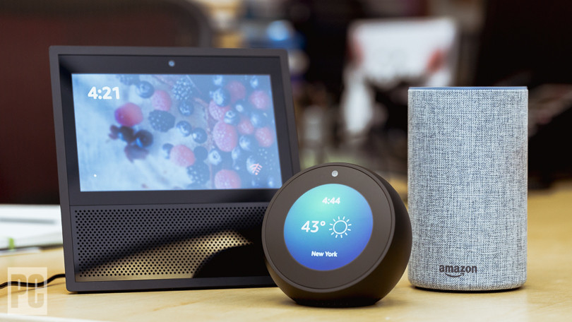
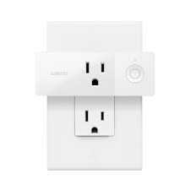
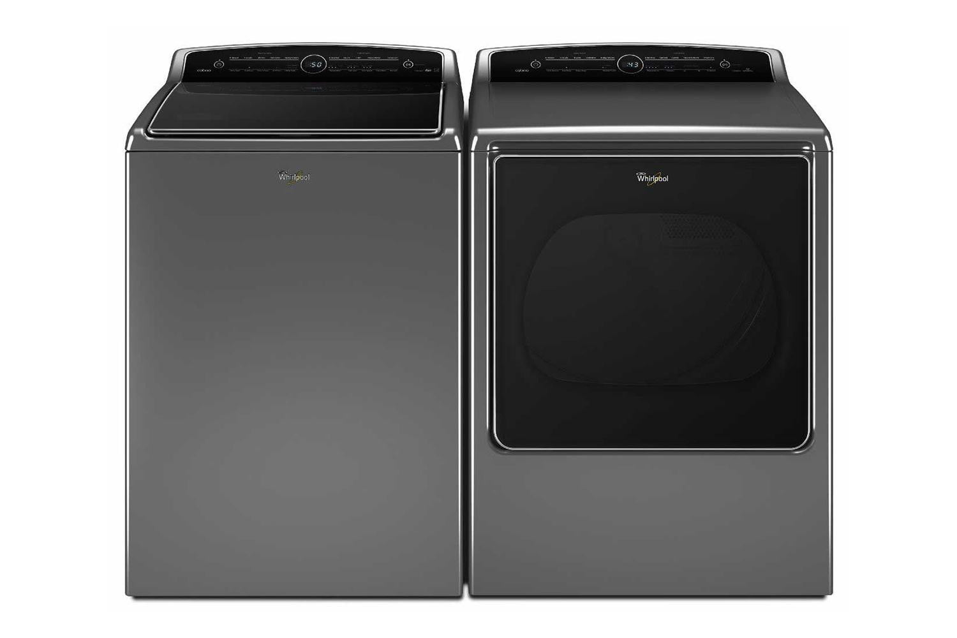
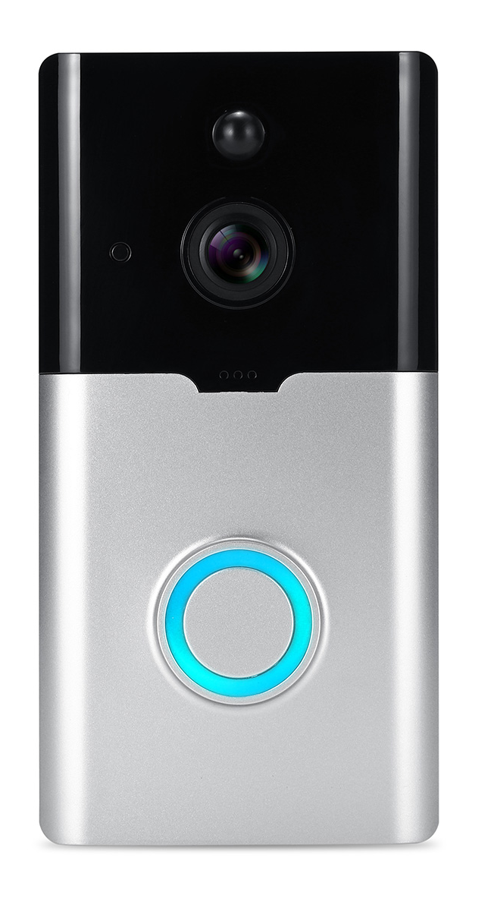
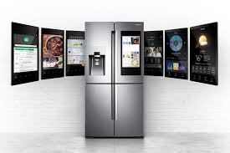
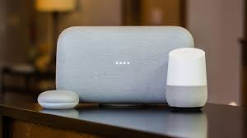
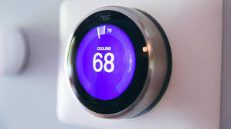

Slide 8
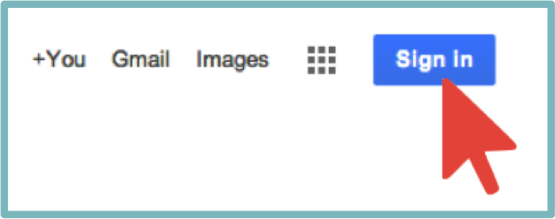


Slide 13


Slide 15
Primary Keys
Phone number
Email
Address
IP
IMEI
Credit card

Slide 18
Essentials

Slide 19
Essentials
Phone

Slide 20
Phone
Considerations
New phone
New phone number
Don’t use the number linked to your SIM card

Slide 21

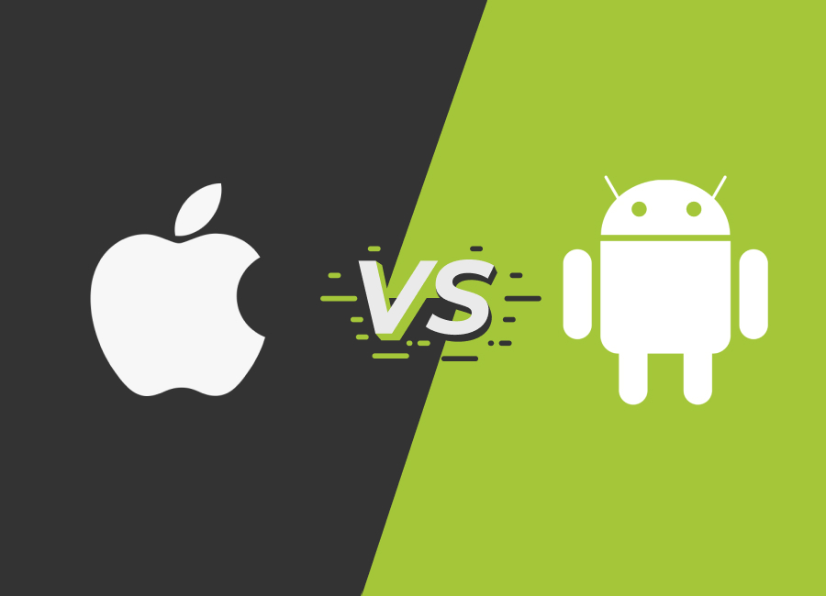

Slide 22


Secure != Private

Slide 24
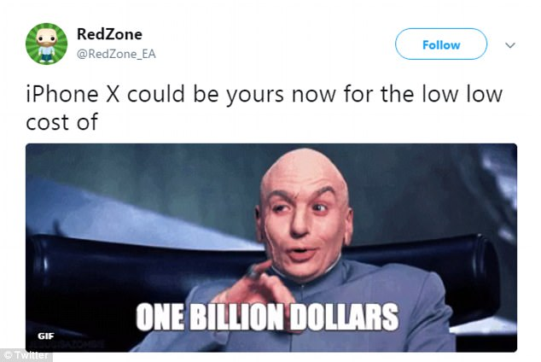

Slide 25
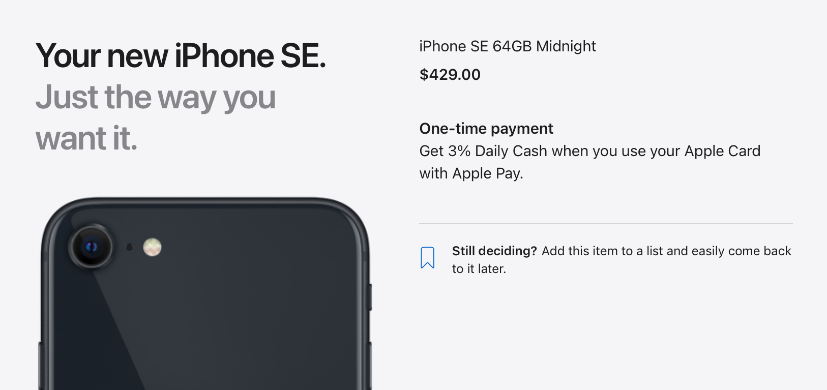

Slide 26

Phone
iOS alternatives
GrapheneOS
Android-based
“Fork” of CopperheadOS
Most private by design
Not usable in most instances

Slide 29
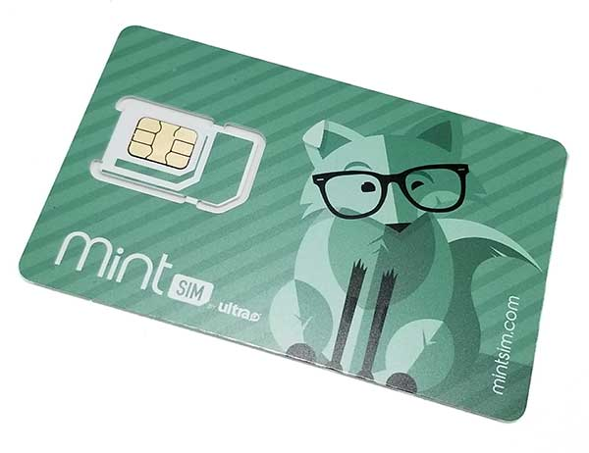
Phone
Cell Service
Prepaid solutions
Doesn’t require verification
Can be purchased with cash

Slide 30
Phone
Phone Number
Multiple VOIP numbers
Calling out to non-Sudo numbers
Use in lieu of SIM card phone number

Slide 31

Phone
Old Phone Number
Maintain control of old number
Already have a Gmail account
Cost-efficient

Slide 32
Essentials
Phone

Slide 33
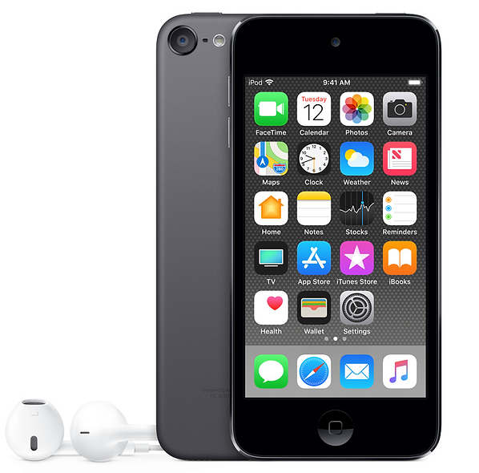


Slide 34
Essentials
Phone
Computer

Slide 35
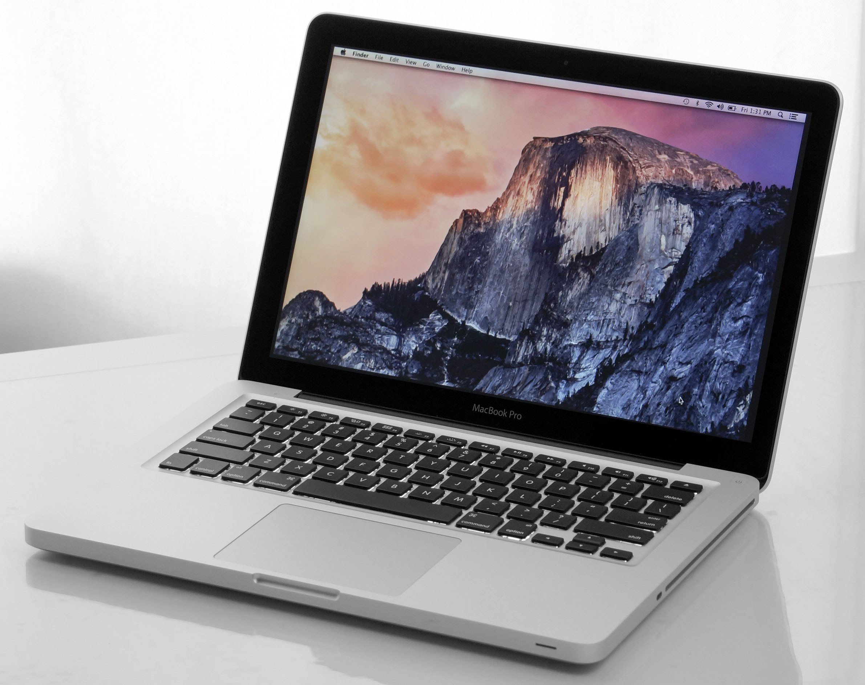


Slide 36
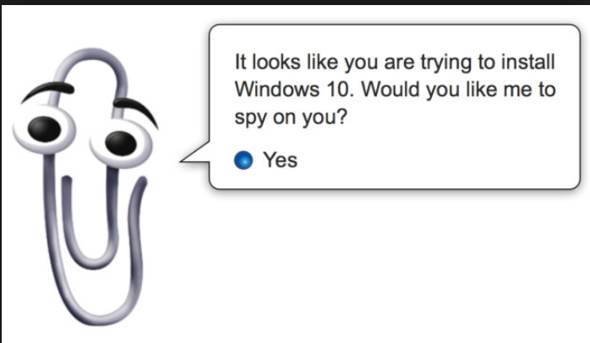

Slide 37
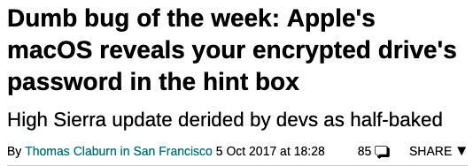

Slide 38
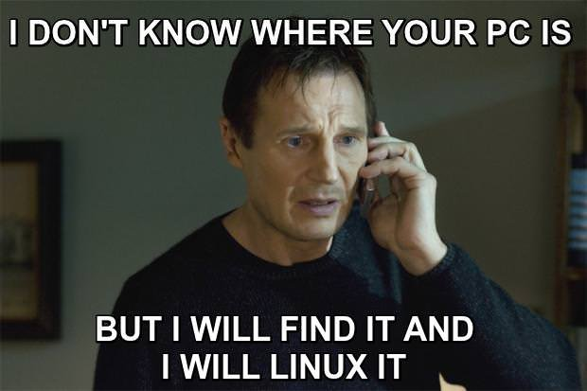

Slide 39


Slide 40


Slide 41
Essentials
Phone
Computer

Slide 42
Essentials
Phone
Computer
Email

Slide 43

Email
Considerations
Privacy-focused provider
Create new account – meaningless address
Do not use this account anywhere

Slide 44




Email
Providers

Slide 45


Email
Usage
On-the-fly alias services
Forwards email to true account
Custom aliases per service/solution

Slide 46
Essentials
Phone
Computer
Email

Slide 47
Essentials
Phone
Computer
Email
Payment

Slide 48

Payment
Considerations
Per merchant credit cards
Proxy for your true banking info
Purchaser and merchant don’t
know about each other
Privacy.com

Slide 49
Essentials
Phone
Computer
Email
Payment

Slide 51
Practical Example

Slide 52


Slide 53
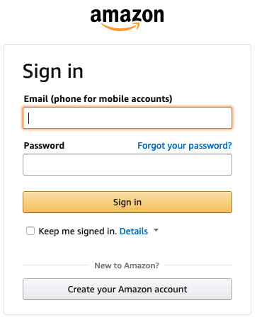

Slide 57
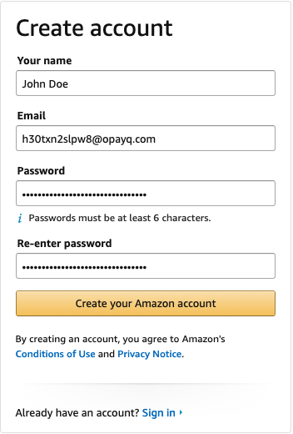

Slide 59
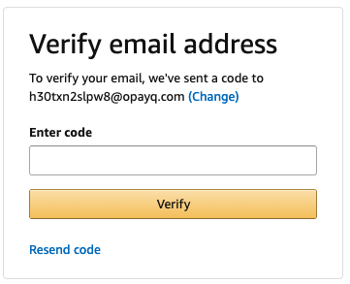

Slide 60
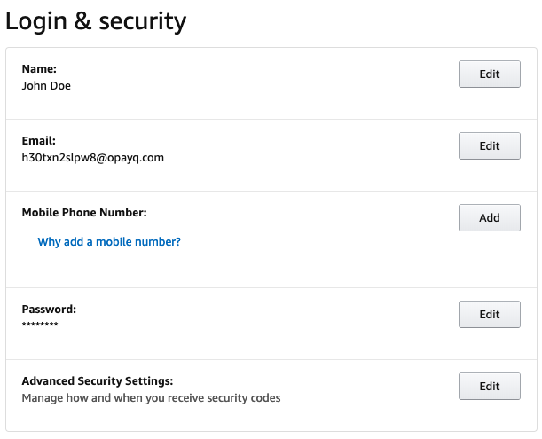

Slide 62
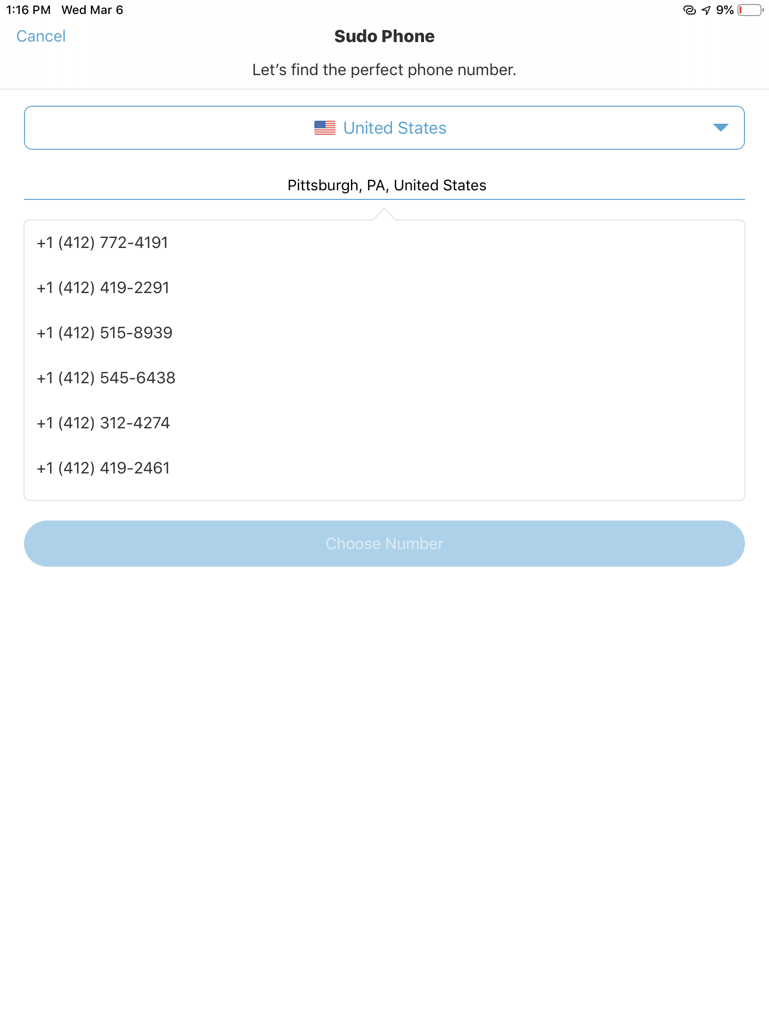

Slide 63
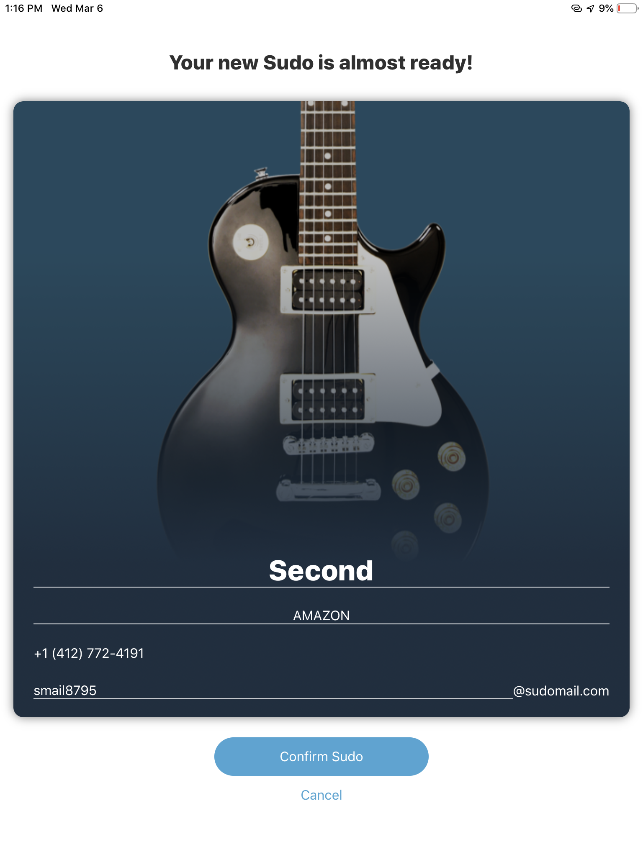

Slide 64
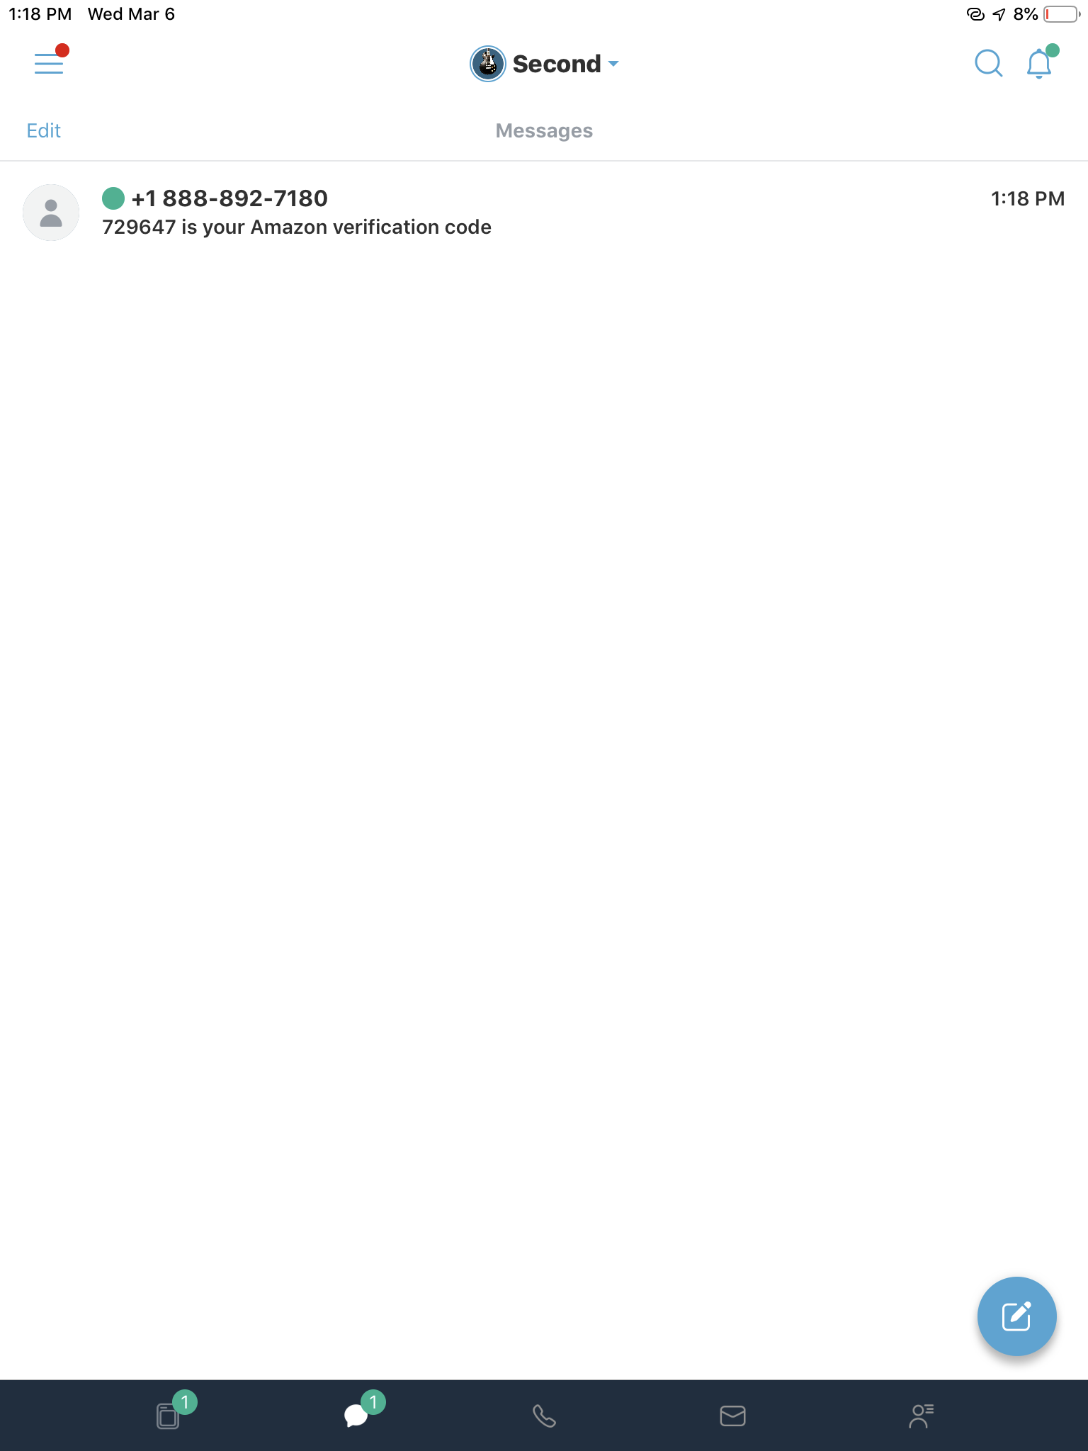

Slide 67
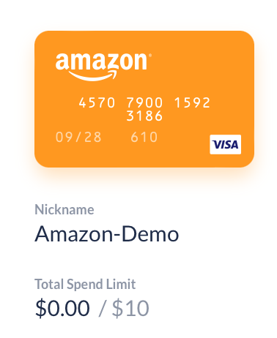

Slide 68
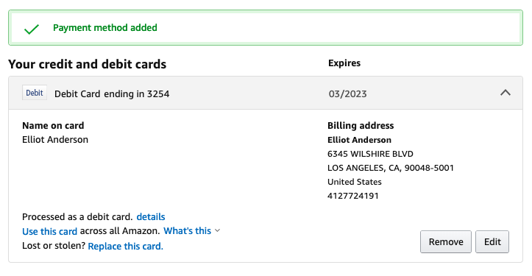

Slide 70
Pro-Gamer Moves

Slide 71
Home Network
ISP
Do not use real name
Pay using Privacy.com
Register with email alias
Local providers vs. ,onopolies

Slide 72
Home Network
ISP - Hardware
Protectli
Intel NUC
Ebay – Craigslist – dumpster diving

Slide 73


Home Network
ISP - Software

Slide 74


Home Network
ISP - VPN

Slide 75






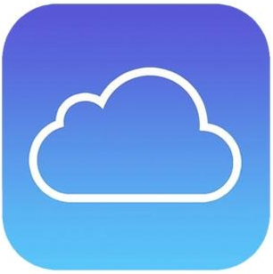



Services
Common Services

Slide 76
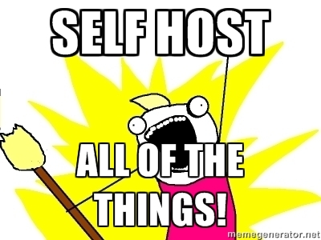
Services

Slide 77








Services
Self-Hosted

Slide 78


Slide 79
Cons

Slide 80
Cons
Technical Issues
Not all services like “disposable” numbers
Not all retailers accept prepaid cards for purchases
Added complexity

Slide 81
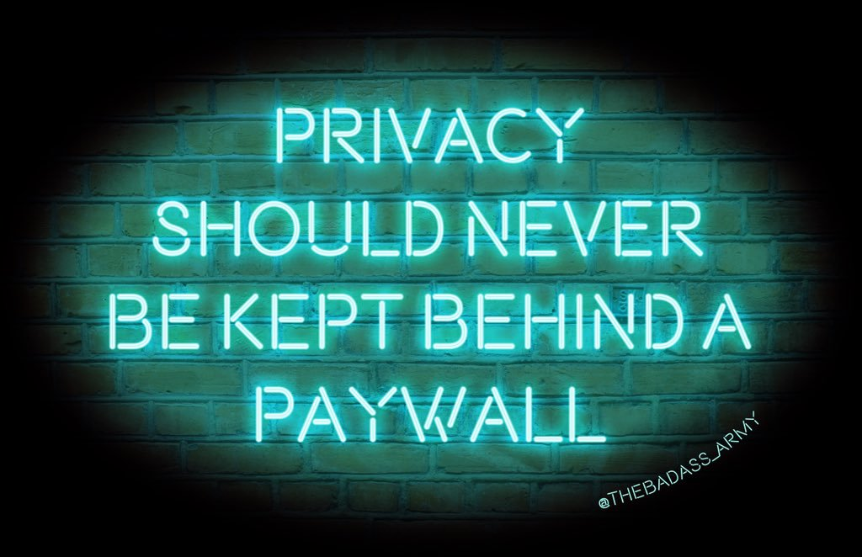
Cons
The Truth
Money
Privacy Fatigue
Does not account for anyone else

Slide 82
What Can We Do?

Slide 83

What Can We Do?
Advocate for Least Privilege collection
Support organizations fighting for end-user rights

Slide 84
Questions?

